Slide 1
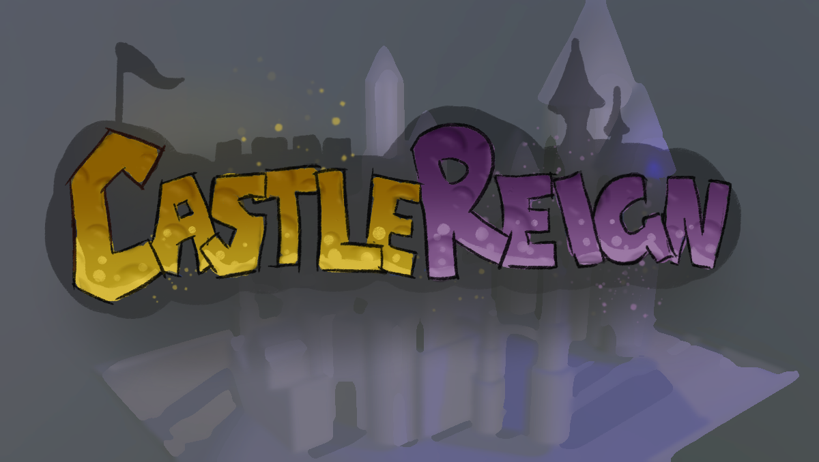
Art Bible
Camo Collective

Slide 2

About
Castlereign is a fun and competitive multiplayer medieval stylised game where players can choose different game modes to compete against other players to become the ruler of the kingdom. The game is set within a medieval castle with multiple surrounding towns being the areas where players will face off against each other with each town having a different minigame zone. The game consists of a collection of variety mini games where player test each of their skills to win rounds towards the wining prize.

Slide 3
Context
About
Roles
Schedule
Milestones
Convention
Asset Lists/Tiers
Software’s
Naming Conventions
Mood-board
References
Concepts

Slide 4
Roles
Daniela-Organic/Art Director
-Character/Creature sculpting
-Texturing
-Animations
-Concepts
Aurora-Technical Artist
-Character
-Rigging/Skin weights
-UI
-Particles
-Texturing
-Animations
Ben-Environment Artist
-Hard surface models
-Overall environment
-Animations
-Texturing
Backup Roles/tasks:
Blake
-Designer
Simo
-Programmer
Daniela: Helping out with UI, tweaking environment textures
Ben: Animations, particles
Aurora: Modelling assets, environment

Slide 5
Task Roles
Ben | Daniela | Aurora
Castle | Character/Creature Concepts | UI
Walls + Windows | Character/Creature sculpting | Rigging
Towns asset packs | Topology | Skin Weights
Shop stales | Texturing | Animation
Turkey Jousting sticks | Assembling Art Bible | Particles
Animations |  | Knight
Environment Bloc-kout |  | Princess

Slide 6
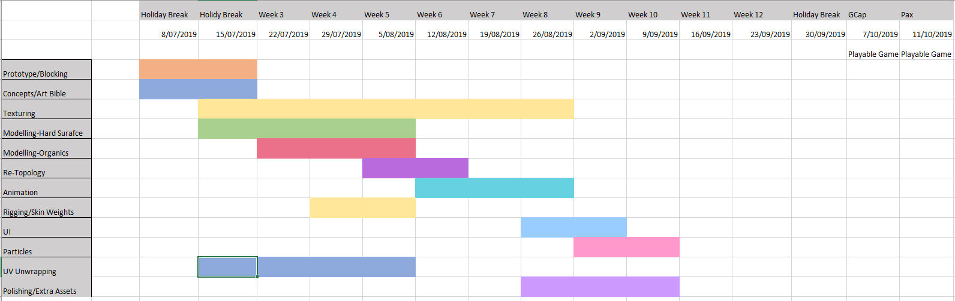
Schedule

Slide 7
Milestones
Pre-Production (8/7/19): By this time, artists will be handed a schedule and asset lust. Concepts, Art Bible’s and simple block-out prototypes should be started to gain an overall fell of the game.
Production (5/8/19): Modelling should at least be started by now along side some texturing, characters should also have at least a base sculpt by now as they have other stages to go through such as rigging, topology, skin weights etc. Hard Surfaces should be UV unwrapped after they have been modelled.
Production (26/8/19): Rigging and skin weights will be the heavy load for the technical artist. They will need to be started asap as each characters will have their own personality trait in their animations. Some characters will also need different rigs such as the creatures, this will also leave room to polish animations.
Production (16/9/19): UI and Particles should begin production, UI won’t take long do they are left later in the schedule, particles wise, we are only using about 3 main particles in the game. Particles will need to be started before UI as they need to be passed onto the programmer.
Production (23/9/19): Artists should be polishing their assets, animations, textures etc. Any left over time could be spent making extra assets.

Slide 8
Conventions
01_Pre-Production: Planning stage of the game where artists should discuss and organise the games overall art style. This will branch into smaller sub divisions such as concept art, colour palette, reference images etc. The art style should be consistent alongside the games UI elements. In addition, sorting asset lists and important tiers will insist in arranging roles, tasks and budgets.
02_Prototype: Simple shapes such as cubes for blocking should start being implemented to map out the games overall asset layout. It is advised that artists should not start polishing stuff in this stage as it is time consuming.
03_Production: Once a prototype has been mapped out, artists should start swapping old items with newer versions. Artists should follow closely to the art bible with their references. This stage includes starting to create the important items followed down to the least important. In addition, the production stage includes sculpting characters, rigging and animating, texturing and create extra elements such as UI.
04_Final Production: The final result of the production should be polished game with all assets with their working conventions. Extra assets may be modelled as well as adding extra particles, animation etc.
05_Feedback and Evaluation: Finishing stage of the major production is where artists receive feedback and explain what they did with the feedback they received. They should be honest with their self evaluation in their post modern and explain what they could have done differently.

Slide 9
Asset Lists
Hard Surfaces
-Walls + Windows
-Castle-Towers
-Turkey Jousting sticks
-Shop stalls
-Arena
-Dungeon
-Tents
Organics/Textures
-Wizard
-Knight
-Barbarian
-Princess
-Pig
-Dragon
-Beard-Punzel
-Ground Textures
UI
-Buttons
-Borders
-Scoreboard?
-Backdrop
Particles
-Dust
-Water droplets
-Campfire
-Clothes line
-Fountain
-Fruit boxes
-Barrels
-Flags
-Carts
-Fences
-Foliage
-Extra small animals etc. rats
-Fireflies
-Dragon Puff
Extra

Slide 10
Tiers
Tier 1
Castle
Characters/Creatures
Animation
Township packs
Textures
Tier 2
UI
Particles
Asset packs etc. carts,
Tier 3
Extra assets
Voice acting
Extra Particles
Extra Animation

Slide 11
Tiers-Castle
Tier 1 Assets
Castle pack
Towers
Windows
Doors
Walls and floor
Building
Town pack
Buildings (walls, roof, Windows)
Shopping stall
Cart
Game mode items
Turkey stick
Tier 3 Assets
Rocks and trees
Flag
Well
Clothes line
Potato sacks
Wood piles
Crates
Lanterns
Benches
Statue
Fruit
Tier 2 Assets
Fountain
Barrels
Fences
Fruit boxes
Dragon nest
Windmill

Slide 12
Character/Creature Animations
Most important to least important
Idle
Run cycle
Climb
Knock off the pig
Jump backwards when getting hit

Slide 13

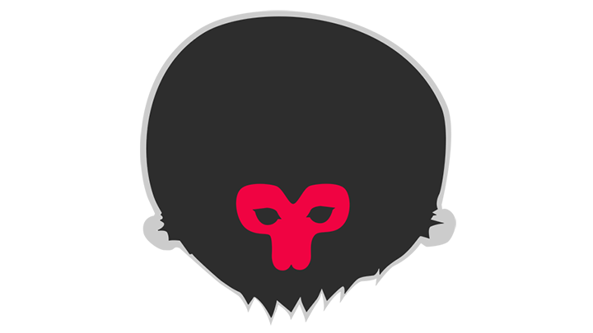





Software’s
Marmoset
Rendering software that can be used to showcase the model for portfolio renders as well as baking normals
Unity
Overall game engine, artists can place assets/characters in themselves
Zbrush
Overall sculpting software to model the character and creatures as well as anything organic
Substance Painter/Designer
3D painting software to map out textures. Designer can be used for procedural texturing such as paths, roads etc.
Maya
Overall animation, topology, rig and weapons will be modelled
Photoshop
Painting software to create the characters textures and concepts

Slide 14
Naming Conventions
Assets
SM_#Model_00#
SM_#Model.fbx
Maya Scene
#Name_#Scene_00#.ma
Textures
T_#Map_#Asset
Zbrush
#Organic_Blockout_00#
#LP_#Organic.fbx
Maya Rigging
#Organic_Rig_00#
#Organic_SkinWeight_00#
SK_#OrganicRig.fbx
Animation
#Animation_#Organic.fbx

Slide 15
Art Requirements
2048x2048 texture resolution
6k character/creature poly count
67k castle pack
10k town pack
512 UI resolution

Slide 16
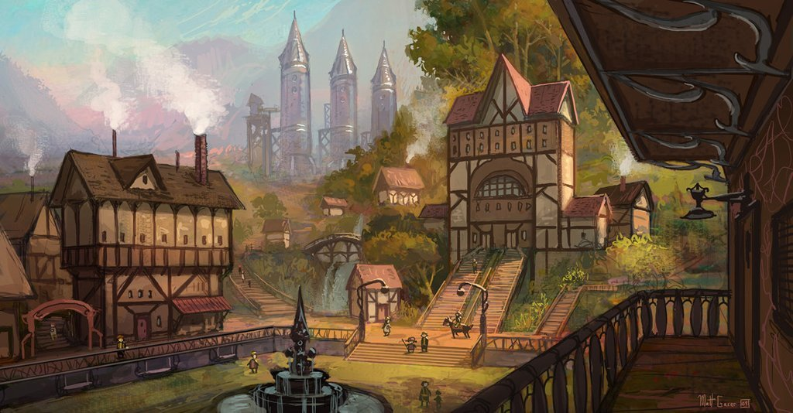
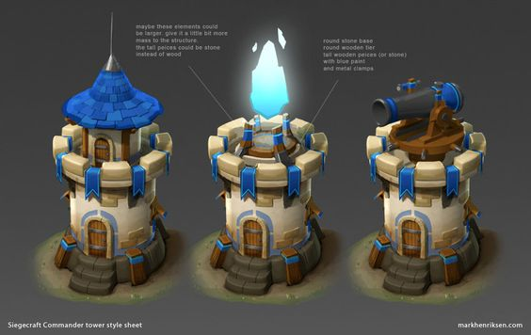
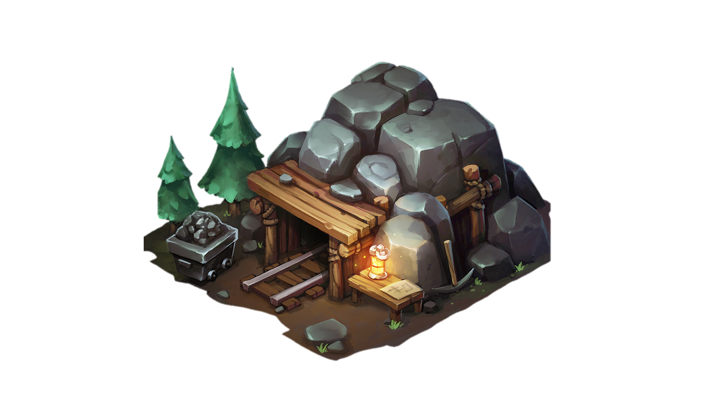
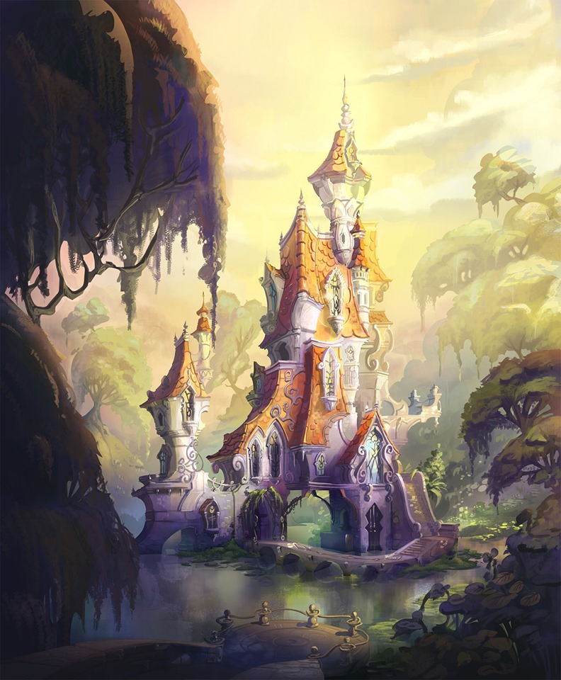
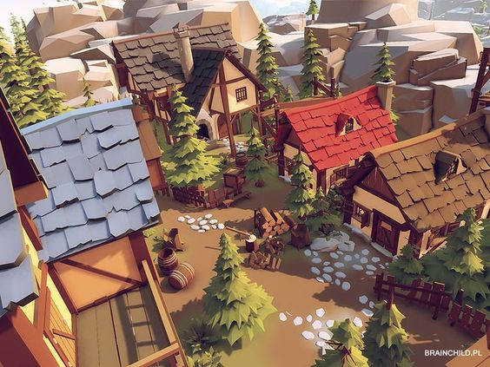
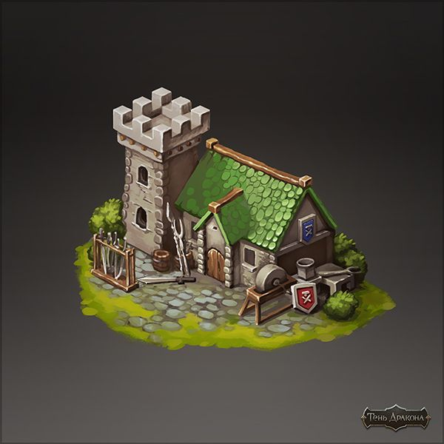
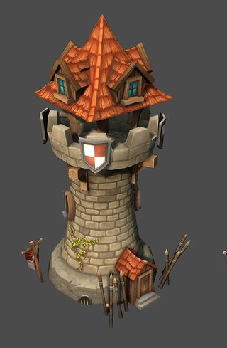
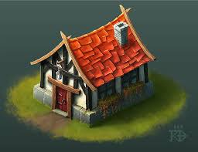
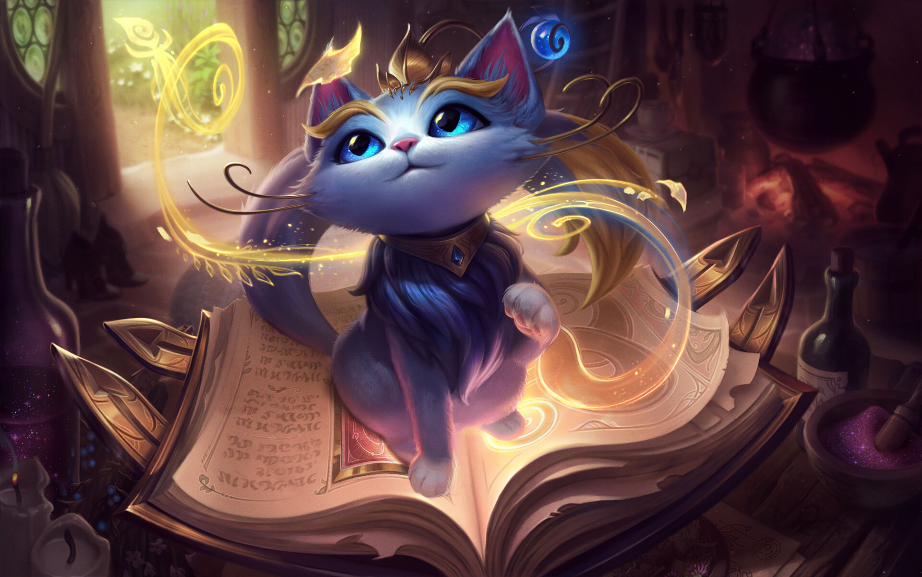
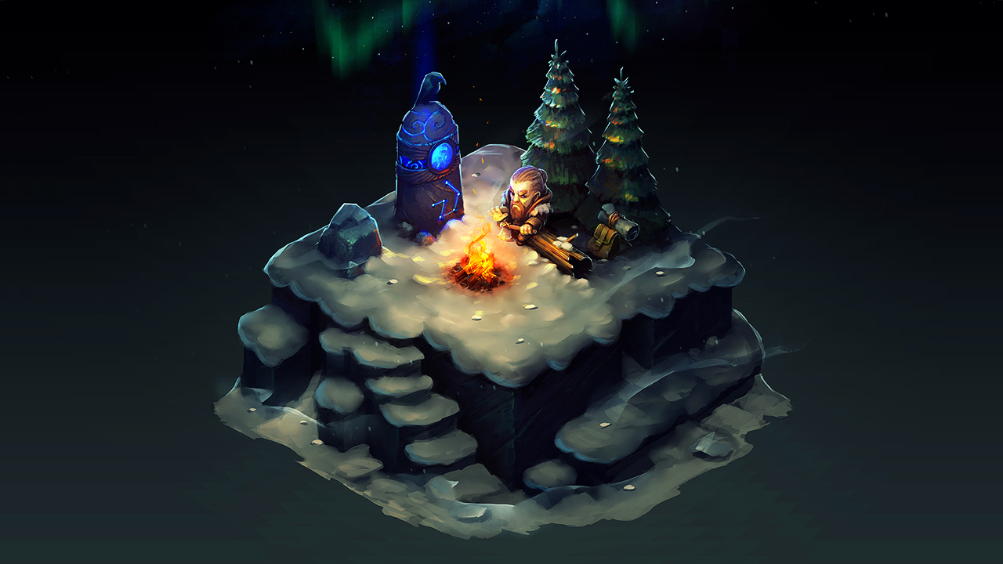
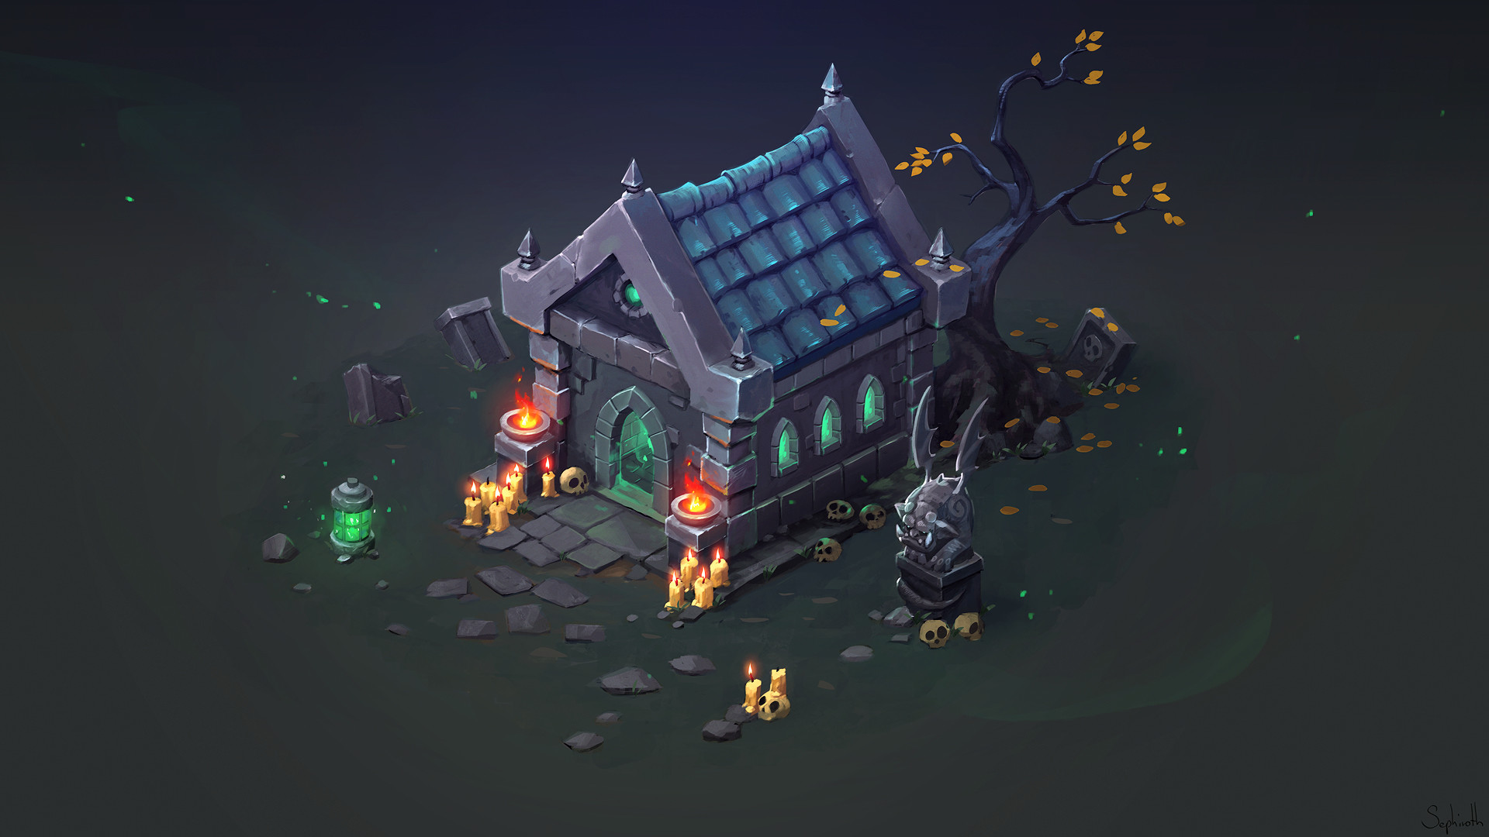
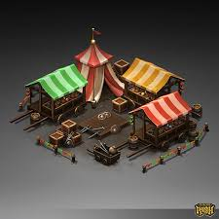
Mood-Board

Slide 17
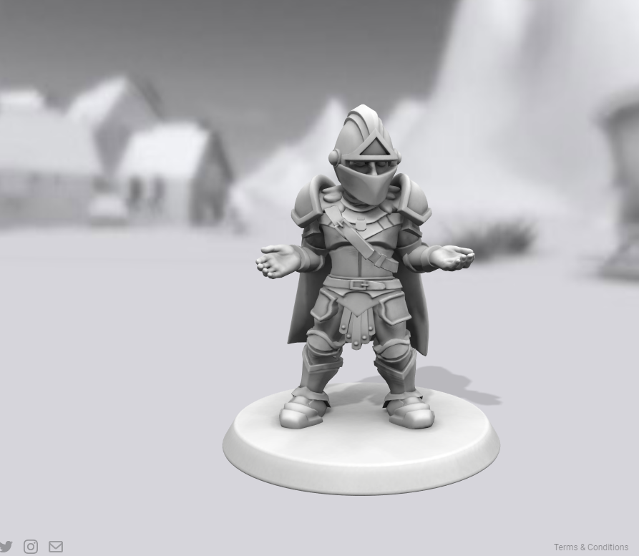
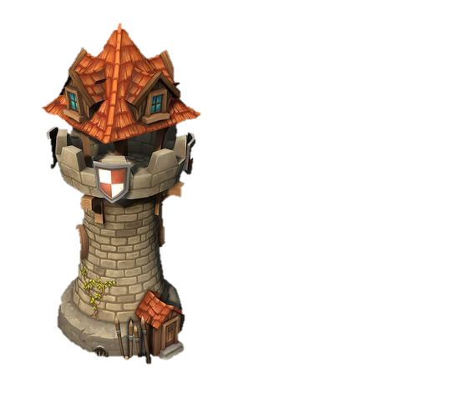
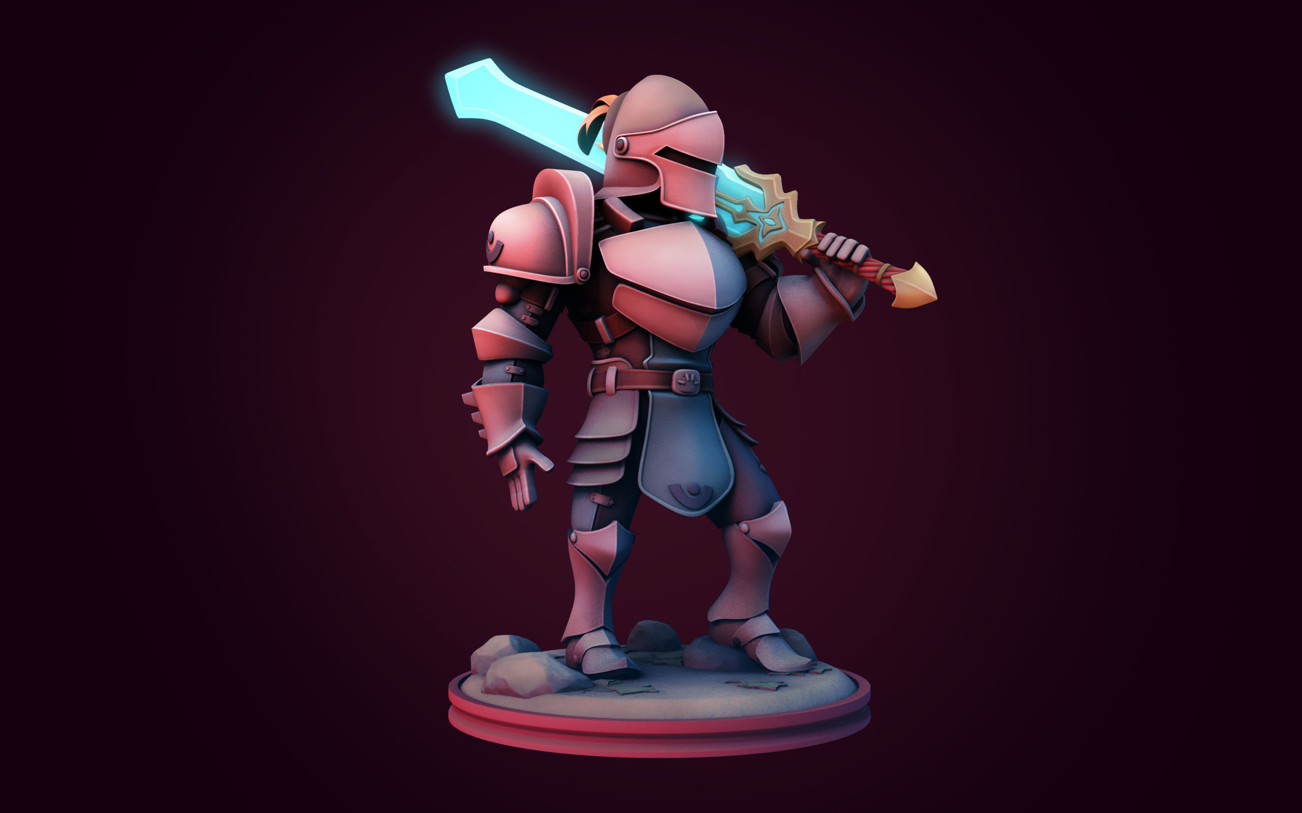
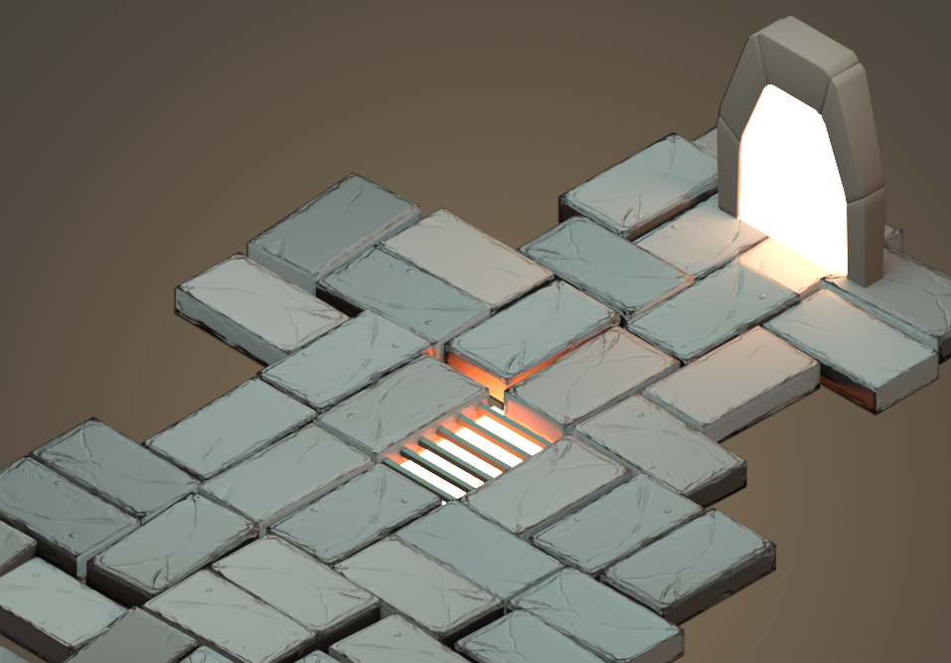
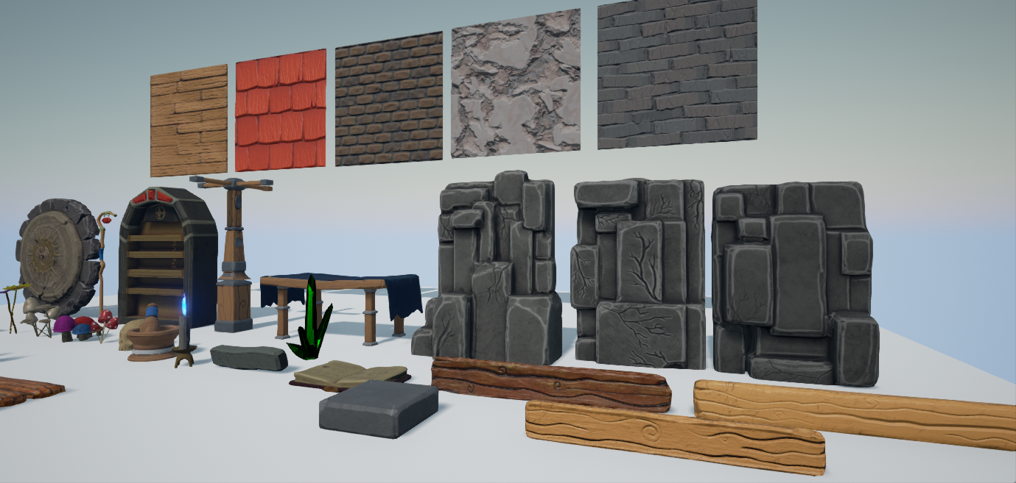
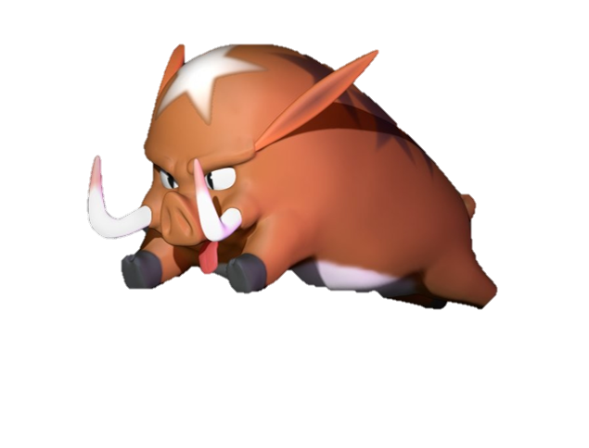
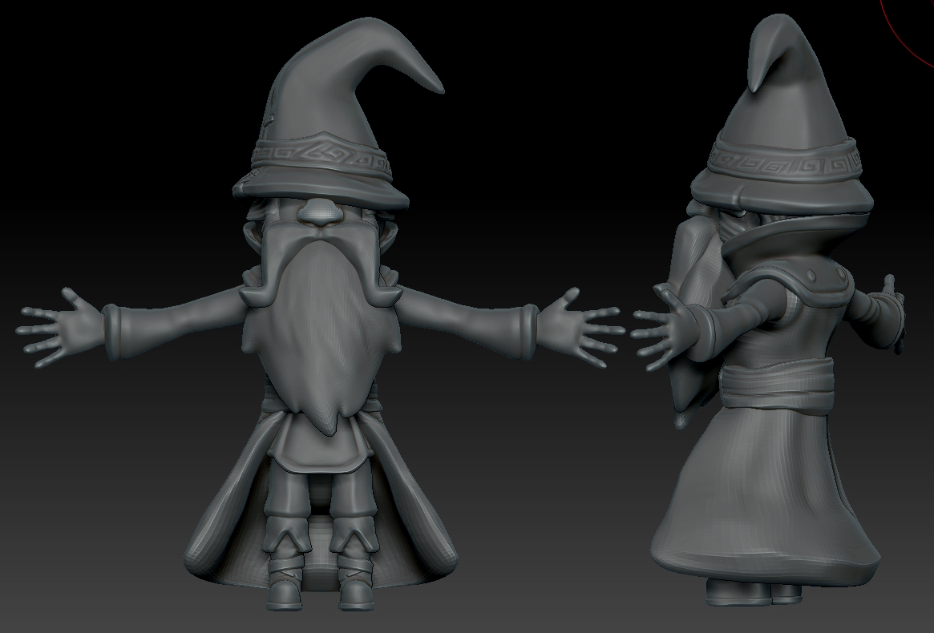
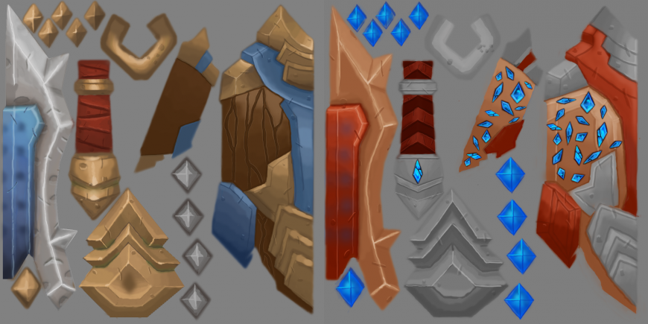
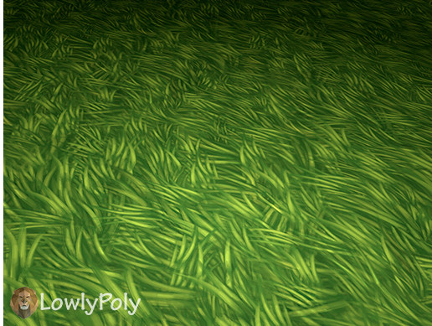
Art Style

Slide 18
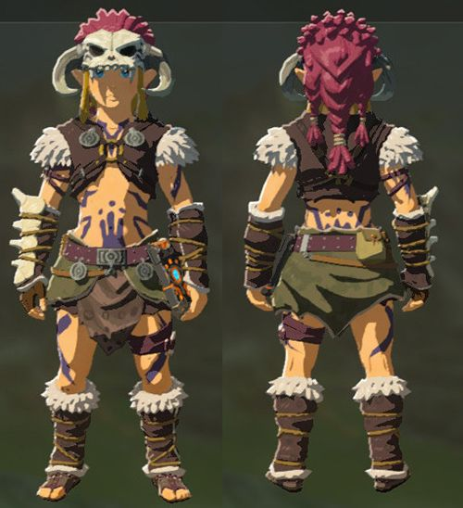
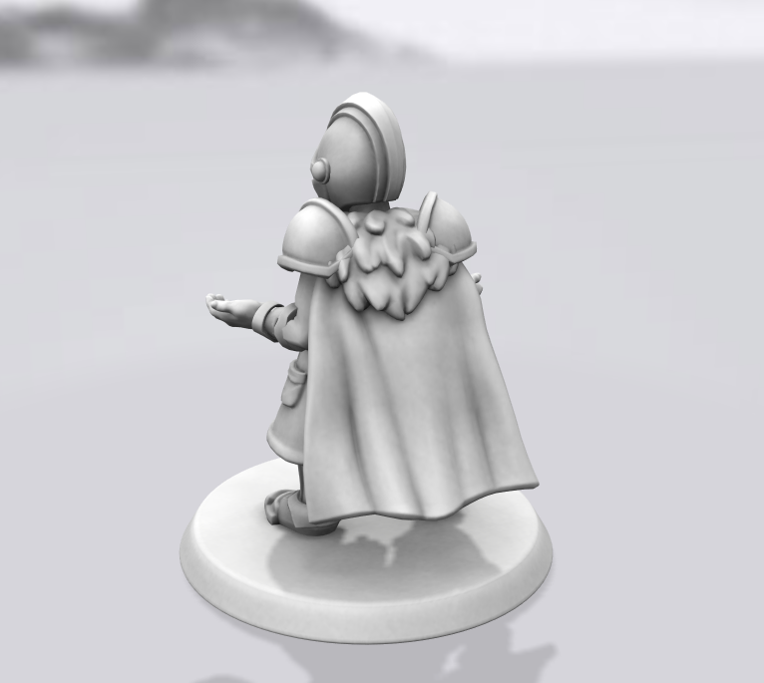
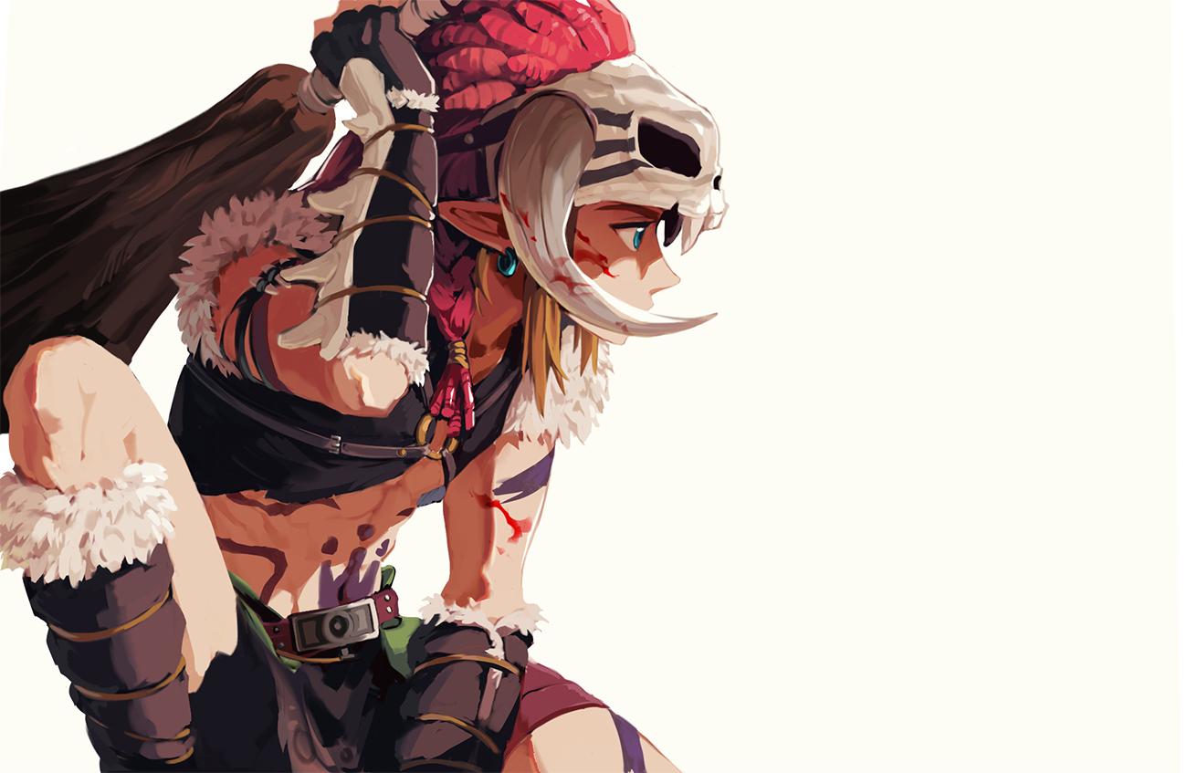
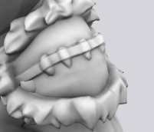
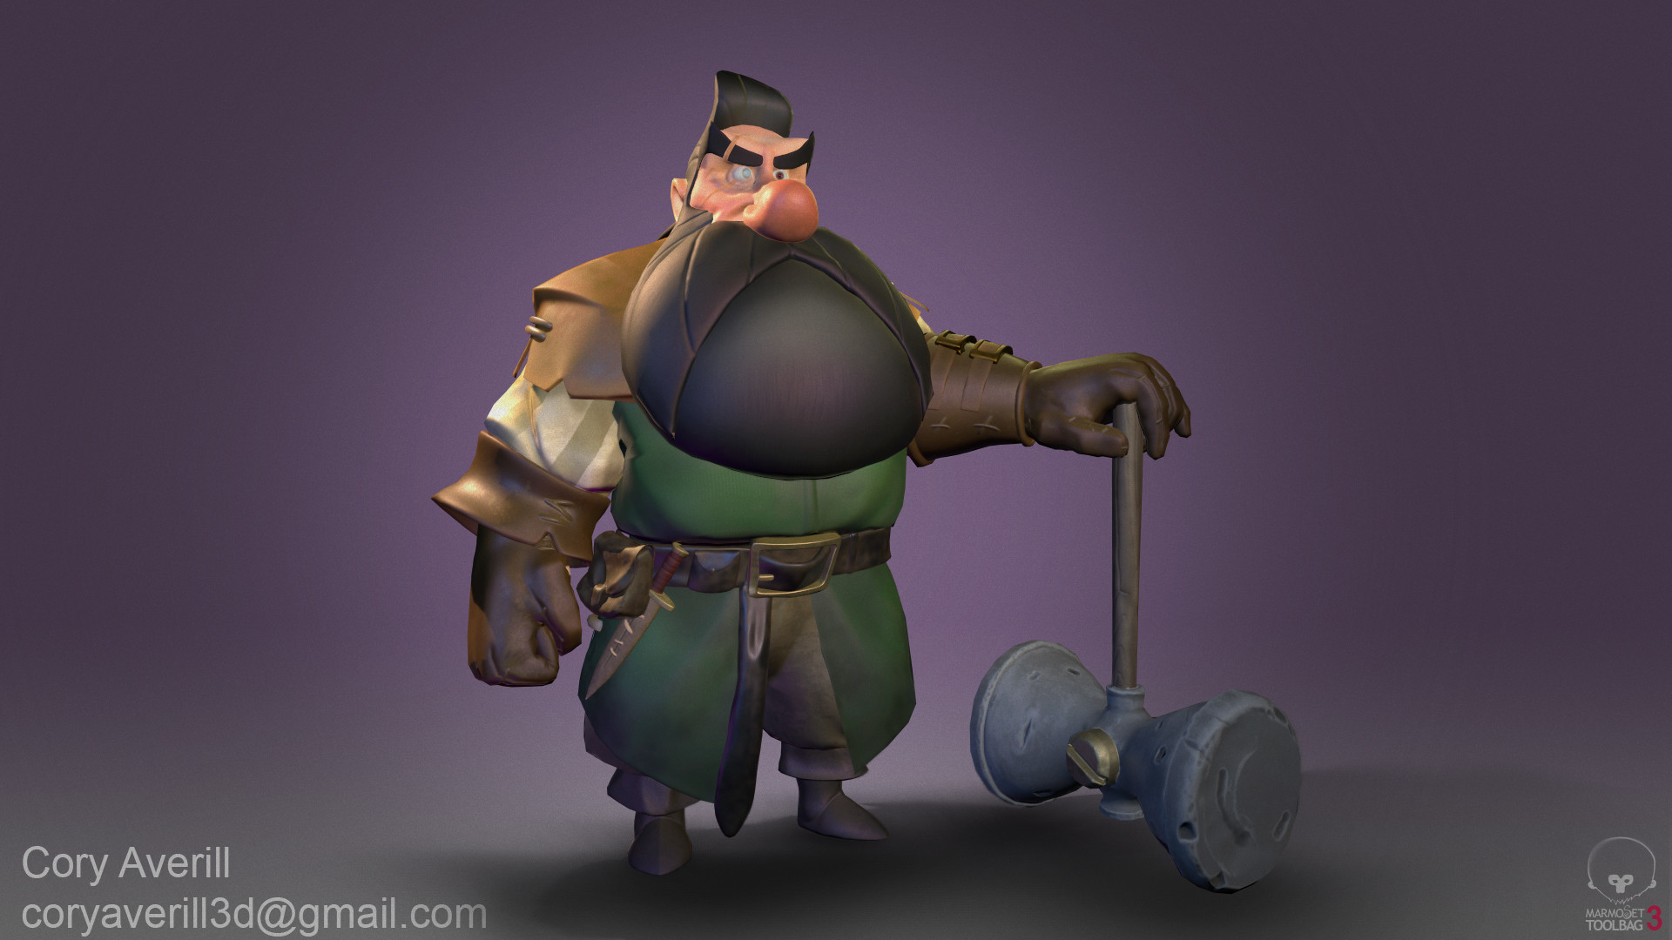
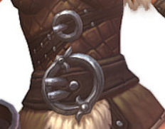
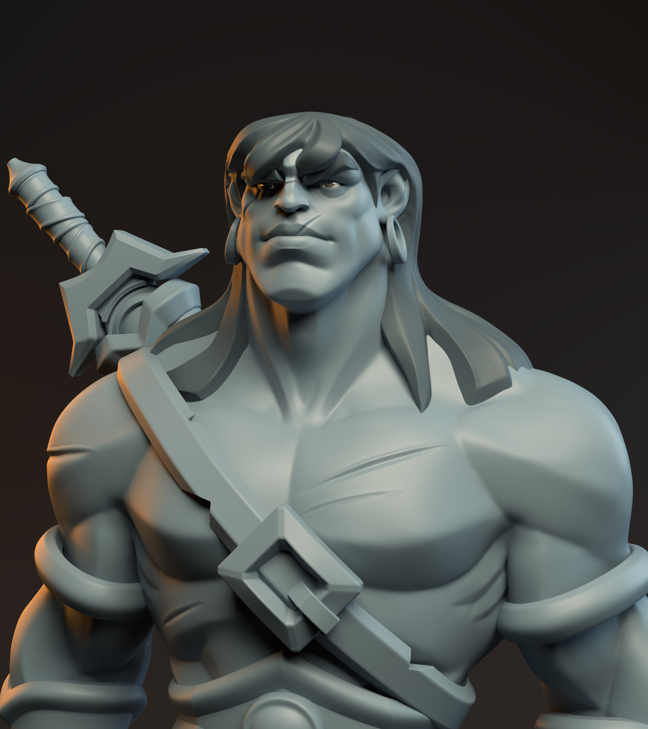
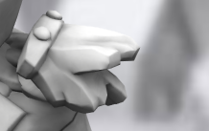
Reference-Barbarian

Slide 19
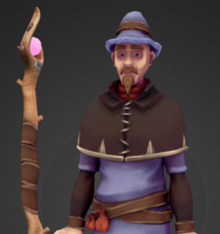
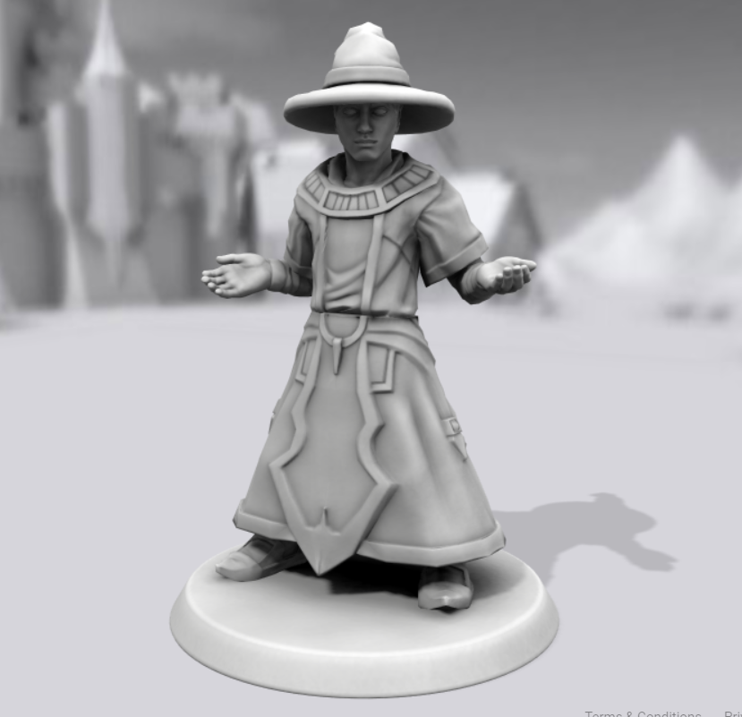
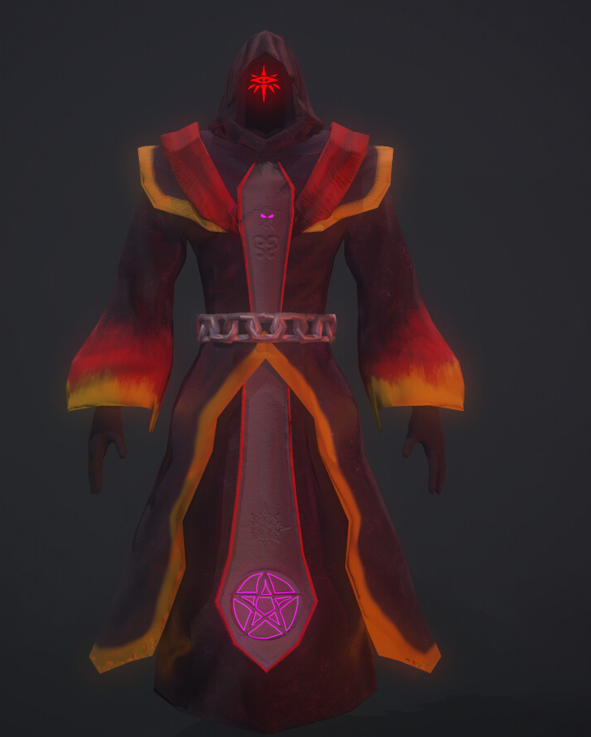
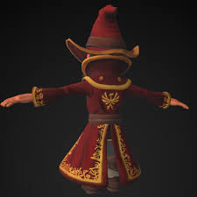
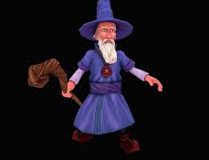
Reference-Wizard

Slide 20
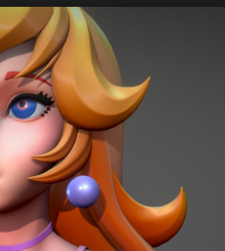
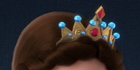
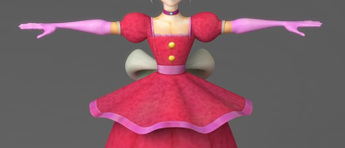
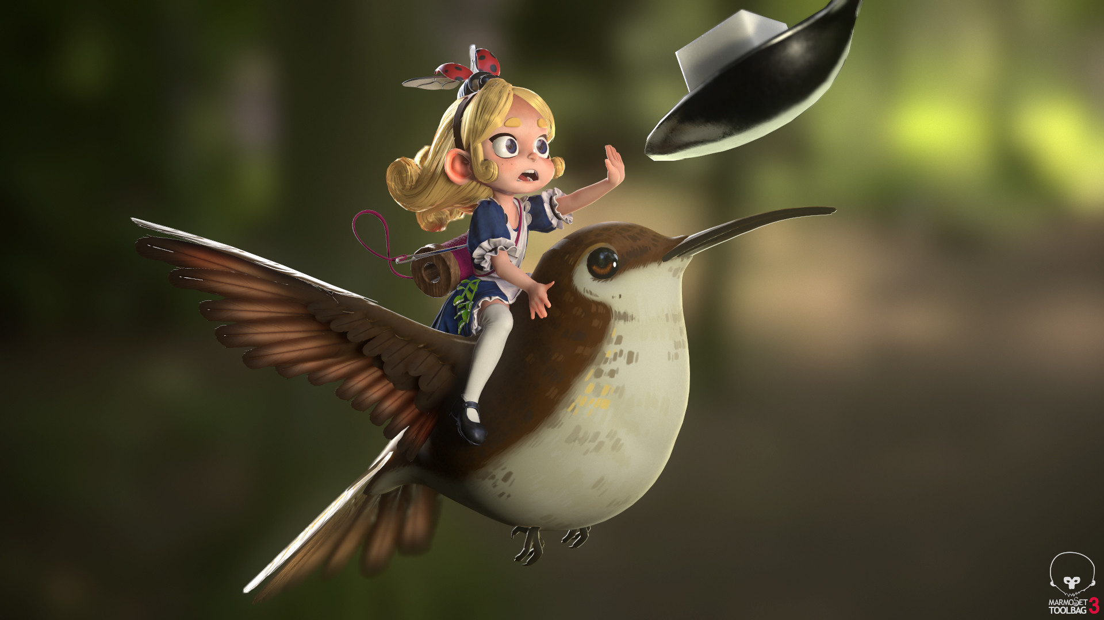
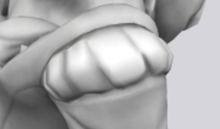
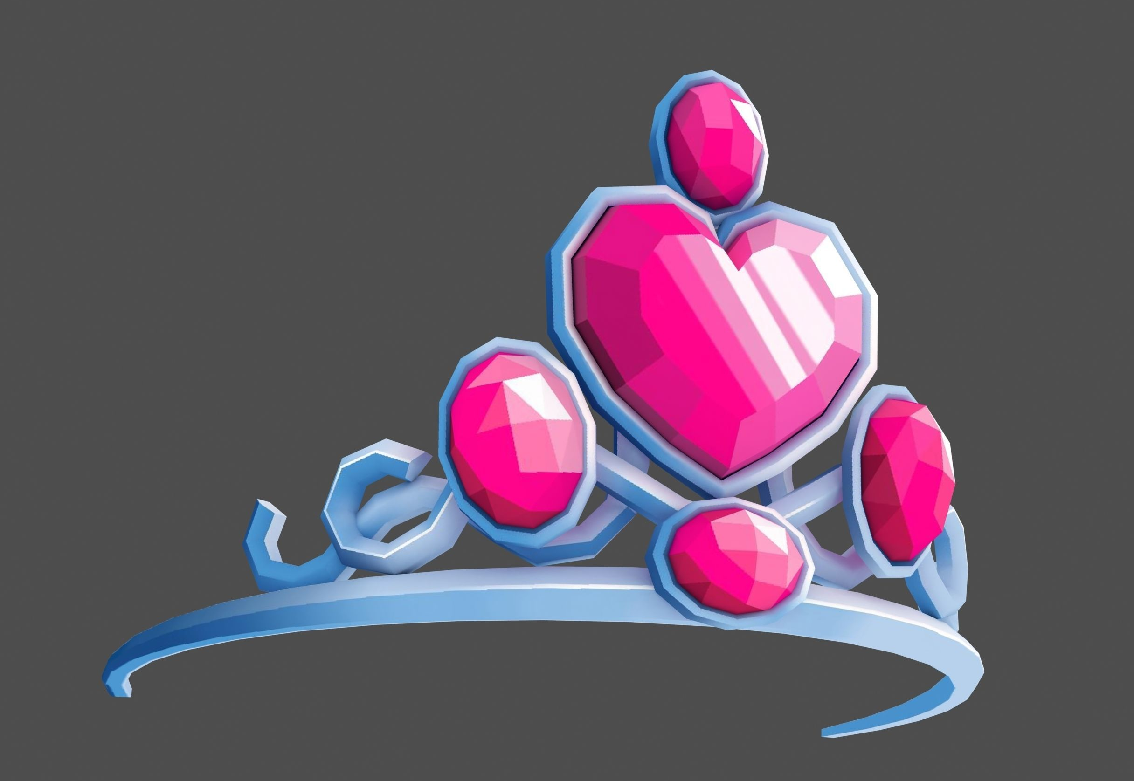
Reference-Princess

Slide 21
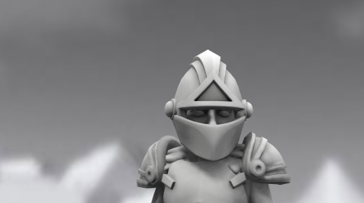
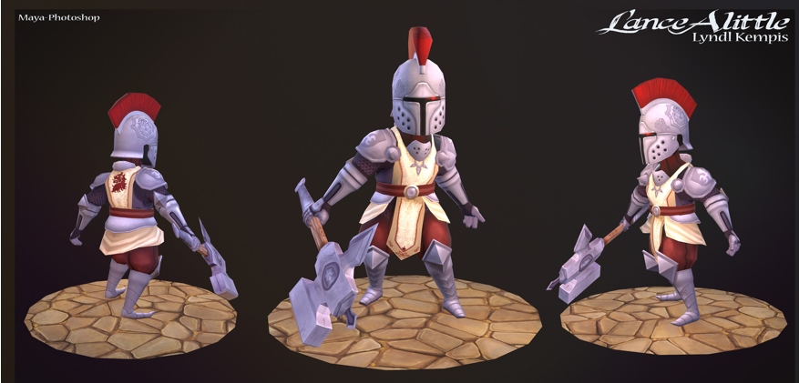
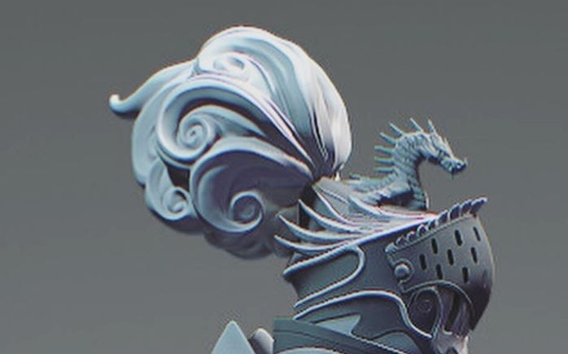
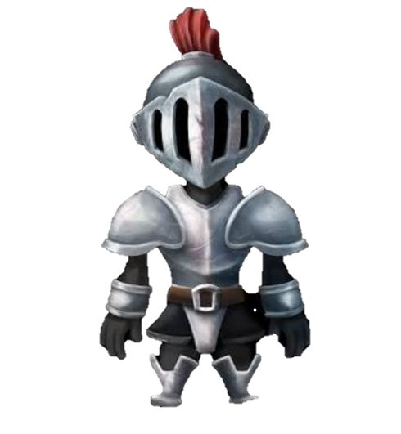
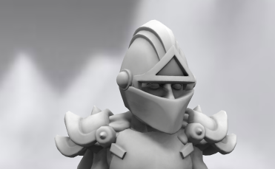
Reference-Knight

Slide 22
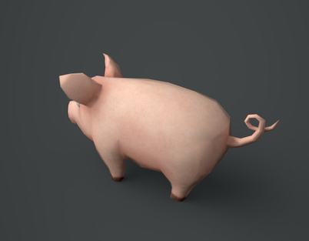
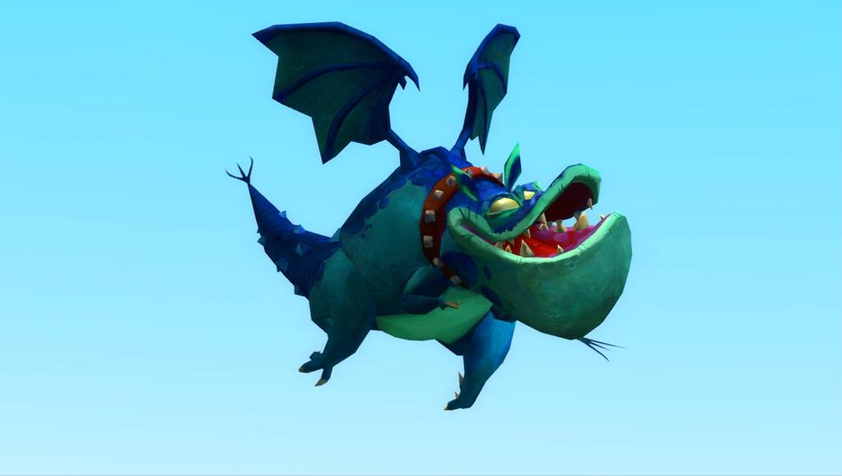




Reference-Creatures

Slide 23










Reference-Castle

Slide 24









Reference-Towns

Slide 25




Reference-Textures

Slide 26














Reference-UI

Slide 27












Reference-Particles

Slide 28

Reference-Fonts
Concepts by Aurora

Slide 29



Reference-Character Base
Base mesh is a guide for the rig and character sculpts with some tweaking e.g. Borris having bigger muscles. This way, the rig can fit all four characters .
Base sculpt by Daniela

Slide 30
















Colour palette by Daniela
Triad
Triad
Monochromatic
Monochromatic
Triad
Triad
Monochromatic
Monochromatic
Complementary
Complementary
Complementary
Complementary

Slide 31







Concepts-Castle
Block-out by Ben
Paint-over by Daniela
Castle Colour scheme by Daniela

Slide 32








Concepts-UI
Concepts by Aurora

Slide 33






Concepts-Borris Bungry
Concepts by Daniela

Slide 34





Concepts-Penelope
Silhouettes by Aurora
Concepts by Daniela

Slide 35





Concepts-Kevin
Silhouettes by Aurora
Concepts by Daniela

Slide 36





Concepts-Herbert
Concepts by Daniela

Slide 37


Concepts-Bearded Bernie
Concepts by Daniela

Slide 38





Concepts-Chonker
Concepts by Daniela

Slide 39






Concepts-Cal
Concepts by Daniela

